Slide 1
MICROCONTROLLER BASED SYSTEM DESIGN
CSE 3216
Lab 6
AUST CSE

Slide 2
Today’s Contents:
LCD
IR SENSOR
PIR SENSOR

Slide 3
LCD (Liquid Crystal Display)

Slide 4
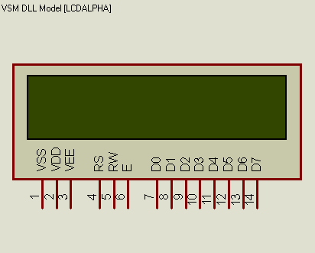
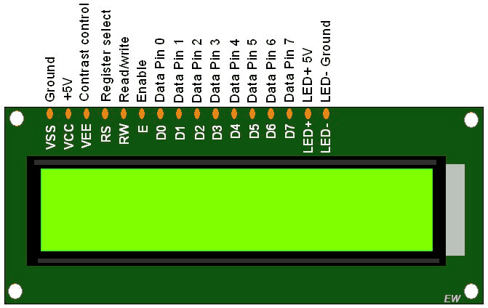
LCD
LCD Model we will use in proteus
LCD Model with Pin Description

Slide 5
Pin No.-> Pin Name | Pin Description | Pin Connection
1-> VSS | Ground Pin | Connect to ground
2-> VDD | VCC pin(for power) | Connect to power supply i.e. 5V
3-> VEE | Adjusts contrast of LCD | Could be connected to a variable POT that can vary the voltage between 0 to 5V, but here we will simply connect it to 5V
4-> RS | Register Select: Toggles between Command/Data Register | Connected to an Arduino pin and gets either 0 or 1. 0 -> Command Mode 1-> Data Mode
5-> RW | Read/Write: Toggles the LCD between Read/Write Operation | If connected to an Arduino pin, it will get either 0 or 1. 0 -> Write Operation 1-> Read Operation However, as Read operation is rarely needed, we typically directly connect it to GND so it will always get 0.
6-> E | Enable: Must be held high to perform Read/Write Operation | Connected to an Arduino pin and always gets 1(HIGH).
(7-14)-> (D0-D7) | Data Bits (0-7): Pins used to send Command or data to the LCD. | In 4-Wire Mode Only 4 pins (0-3) is connected to Arduino In 8-Wire Mode All 8 pins(0-7) are connected to Arduino
15-> LED + [Not present in the model we are using] | LED Positive: used to turn on/off backlight of the LCD | Connect to power supply i.e. 5V [not needed here]
16-> LED - [Not present in the model we are using] | LED Negative: used to turn on/off backlight of the LCD | Connect to ground [not needed here]

Slide 6
LCD (contd.)
4-bit and 8-bit Mode of LCD:
The LCD can work in two different modes, namely the 4-bit mode and the 8-bit mode. In 4 bit mode we send the data nibble by nibble, first upper nibble and then lower nibble. A nibble is a group of four bits, so the lower four bits (D0-D3) of a byte form the lower nibble while the upper four bits (D4-D7) of a byte form the higher nibble. This enables us to send 8 bit data.
Whereas in 8 bit mode we send data byte by byte, so we can send the 8-bit data directly in one stroke since we use all the 8 data lines.
8-bit mode is faster and flawless than 4-bit mode. But the major drawback is that it needs 8 data lines connected to the microcontroller. This will make us run out of I/O pins on our Arduino board, so 4-bit mode is widely used. No control pins are used to set these modes. It's just the way of programming that change.

Slide 7
Add Libraries
Add the libraries for IR, PIR and Ultrasonic sensors to the library folder of Proteus Software:
In C:\ProgramData\Labcenter Electronics\Proteus 8 Professional\LIBRARY
OR
In C:\Program Files (x86)\Labcenter Electronics\Proteus 8 Professional\LIBRARY

Slide 8
Infrared Sensor (Active)

Slide 9
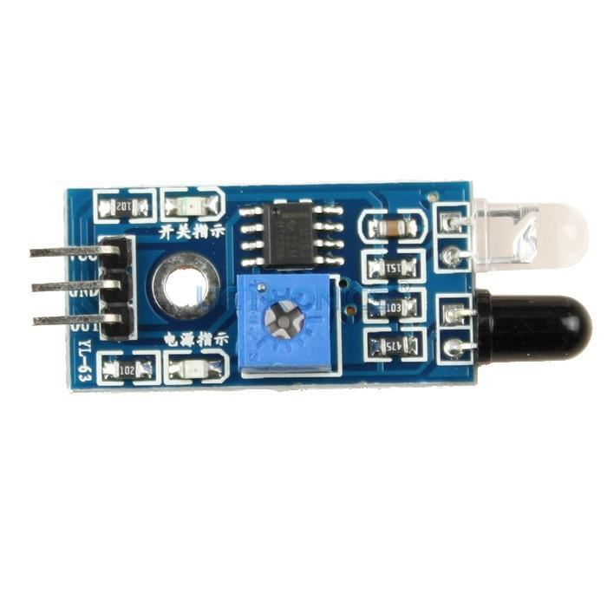
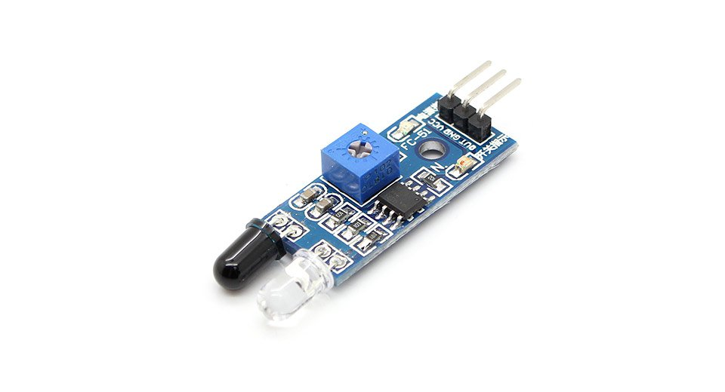
IR SENSOR

Slide 10
IR SENSOR
3 pins: positive voltage(+Vcc), ground(GND) and output voltage(Vout)
Emits light in order to sense surrounding objects
Consists of: emitter(IR source) and detector(IR detector)
Emitter: IR LED-> Emits IR light
Detector: IR photodiode-> Sensitive to IR light of the same wavelength which is emitted by the IR LED
Output determined based on intensity of reflection received by photodiode
Output is binary

Slide 11
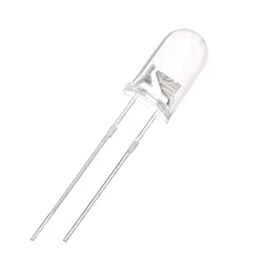
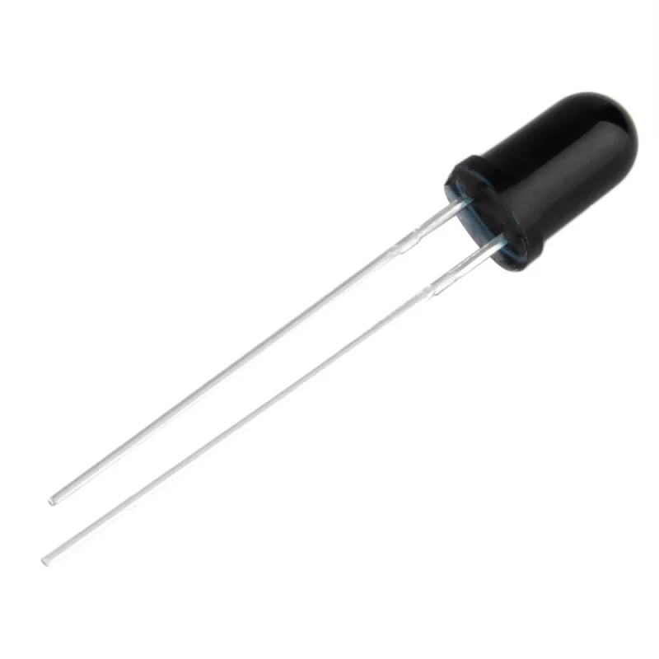
IR SENSOR
IR Transmitter or IR LED
IR Receiver or Photodiode

Slide 12
Infrared Sensor (Passive)

Slide 13
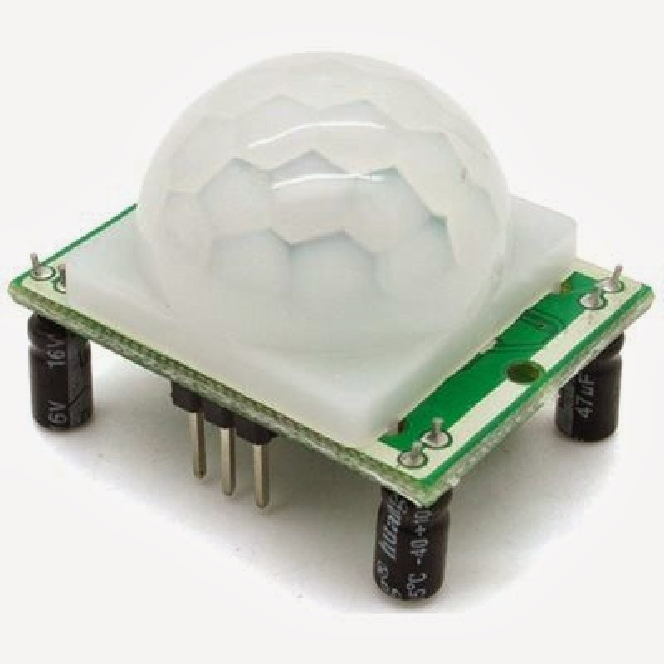
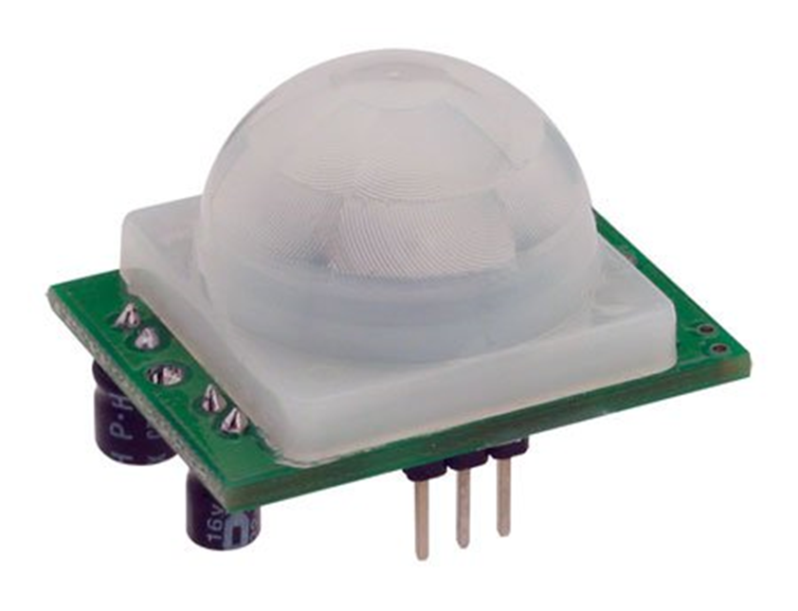
PIR SENSOR

Slide 14
PIR SENSOR
3 pins: positive voltage(+Vcc), ground(GND) and output voltage(Vout)
Can detect thermal radiation of objects in the infrared range
Consists of: 1 pair of pyroelectric sensors, to detect heat energy in the surrounding environment
Sensors housed within a series of lenses
Purpose of lens: widening the device’s sensing area
Output is binary

Slide 15
IR vs. PIR: COMPARISON
IR SENSOR
PIR SENSOR
Contains active emitter
Capable of detecting exact position of objects
Used in: garage door systems, industrial settings
No active emitter
Capable of detecting motion
Used in: security alarms and automatic lighting setups

Slide 16
THE END

